Slide 1
IBM University Engagement Project Submission
“Bhasha Bridge – Multilingual Course Content Translator Agent with IBM Granite”

Slide 2

Project Tile – Bhasha Bridge – Multilingual Course Content Translator Agent
Domain of Project – Education / Artificial Intelligence
Student Name | Recent Passport Photo | Email ID | Mobile number [WhatsApp]
Pratik Bhosale |  | pratikbhosale1534@gmail.com | 9324650763

Slide 3
Problem Statement -
Bhasha Bridge – Multilingual Course Content Translator Agent
The Challenge: Students often face difficulties understanding educational materials because course content is frequently available in languages they are not comfortable with. Technical textbooks, presentations, notes and study documents may contain complex terminology, formulas and explanations that become difficult to understand when language becomes a barrier.
Existing translation tools may not preserve the original document structure, technical terms, mathematical expressions and numerical values accurately.
The Objective : To develop an AI-powered multilingual course translator that helps students understand educational content in their preferred languages.
The solution aims to:
1. Document Upload: Support PDF, DOCX, PPTX and TXT educational documents.
2. Multilingual Translation: Translate course content between English, Hindi, Marathi and other supported languages.
3. Structure Preservation: Maintain headings, bullet points, formulas, code snippets, URLs and numerical values.
4. Student-Friendly Simplification: Convert complex educational content into simpler explanations.
5. AI-Generated Glossary: Identify important technical terms and provide their translations and definitions.

Slide 4
Proposed Solution -
Bhasha Bridge – AI-Powered Multilingual Course Translator
Bhasha Bridge is an AI-powered educational application developed using Python, FastAPI and IBM Granite models through IBM watsonx.ai.
Key Components of the Solution:
1. Document Extraction: Extracts text and structural information from uploaded educational documents.
2. AI Translation Engine: Uses IBM Granite through watsonx.ai to translate educational content.
3. Structure Preservation: Protects mathematical expressions, code snippets, URLs and important numerical values during translation.
4. Content Simplification: Generates easier explanations for complex academic concepts.
5. Glossary Generation: Identifies technical terms and generates translated definitions.
The application uses FastAPI for backend processing, HTML, CSS and JavaScript for the frontend, and IBM watsonx.ai Runtime for AI-powered language processing.
Overall, Bhasha Bridge aims to make educational content more accessible by reducing language barriers and helping students understand complex academic materials.

Slide 5
Technology Used
1. Python: Main programming language used for backend development, document processing and AI integration.
2. FastAPI: Python web framework used to develop backend APIs and handle document uploads, translation, simplification and glossary generation.
3. IBM Granite Model – Granite 4.0 H Small: Used for natural language understanding, academic translation, content simplification and glossary generation.
4. IBM Cloud IAM: Provides secure authentication and access-token generation for connecting to IBM watsonx.ai.
5. IBM watsonx.ai Runtime: Provides the environment for accessing and running IBM Granite foundation models.
6. HTML, CSS and JavaScript: Used to build the interactive frontend and document translation workspace.
7. SQLite: Used to maintain translation history and store generated outputs temporarily.
8. PyMuPDF, python-docx and python-pptx: Used to extract text and structural information from PDF, DOCX and PPTX documents.
9. Vercel: Deployment platform configured for hosting the application.

Slide 6
Application Component Used -
Document Upload Component – Allows users to upload PDF, DOCX, PPTX and TXT educational documents.
Document Extraction Component – Extracts text, headings, lists, tables and other structural information from uploaded documents.
FastAPI Backend – Handles API requests and coordinates document extraction, translation, simplification and glossary generation.
IBM watsonx.ai Integration – Connects the application with IBM Granite models for AI-powered language processing.
IBM Granite Model – ibm/granite-4-h-small – Processes academic content and generates translations, simplified explanations and glossary entries.
SQLite History Component – Maintains previously generated translations and simplified content.

Slide 7
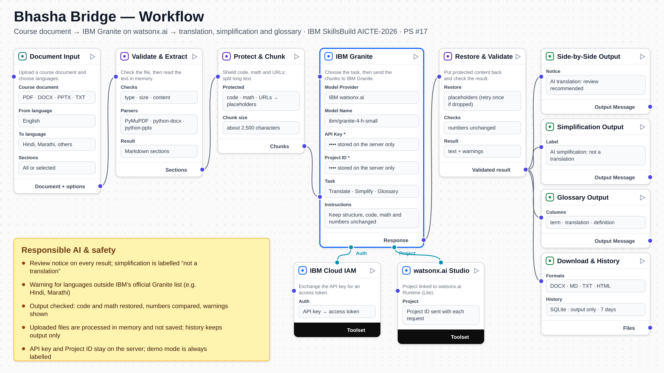
Application WorkFlow -

Slide 8
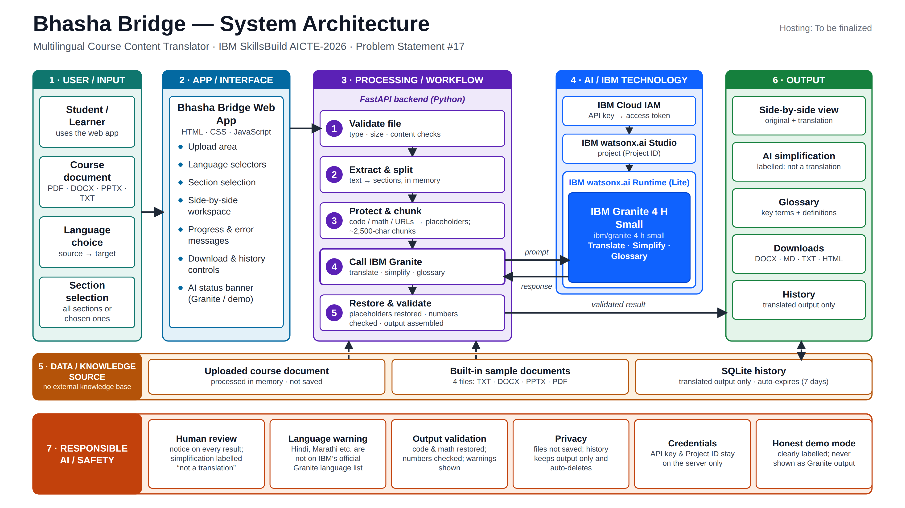
Architecture BluePrint

Slide 9

Role of Agentic AI in the solution
Role of AI in Bhasha Bridge
Bhasha Bridge uses IBM Granite through IBM watsonx.ai to perform intelligent academic language processing.
The AI model performs multiple specialized tasks within the application, including:
1. Intelligent Translation: Converts educational content into the selected target language while maintaining the original meaning.
2. Context-Aware Processing: Understands academic text and preserves important technical terminology during translation.
3. Content Simplification: Rewrites difficult educational concepts into simpler explanations suitable for students.
4. Glossary Generation: Identifies important technical terms and generates their translations and definitions.
Overall, IBM Granite makes Bhasha Bridge an intelligent educational translation assistant that helps students overcome language barriers and understand academic content more effectively.

Slide 10
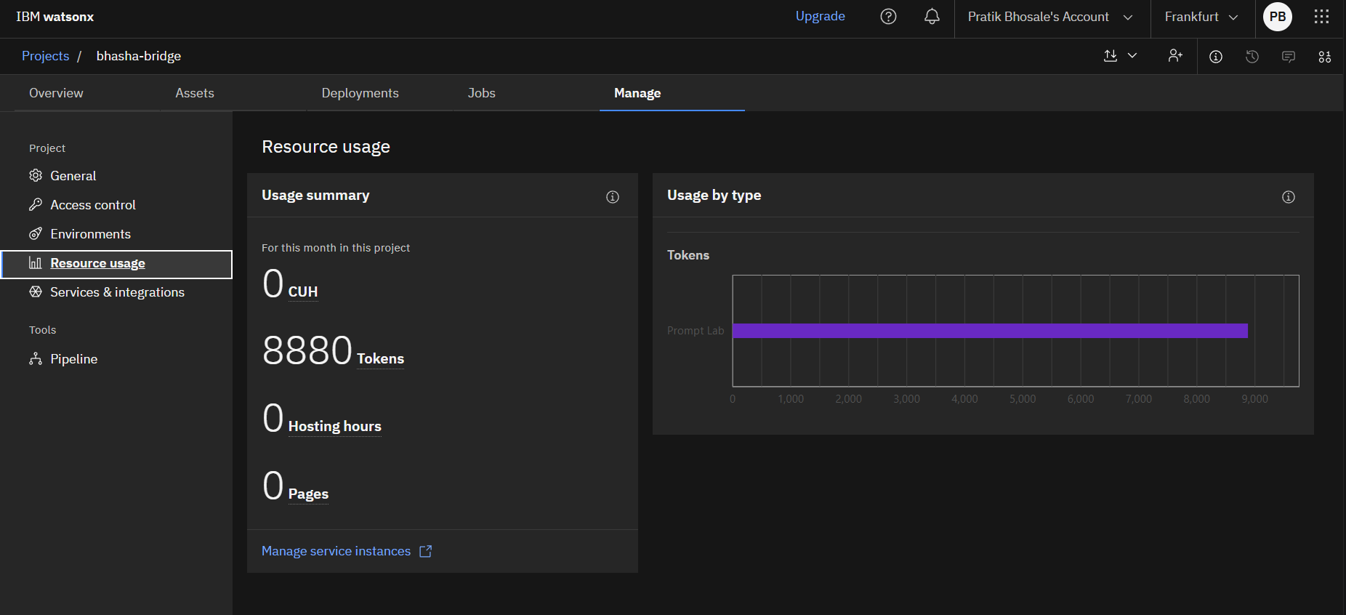
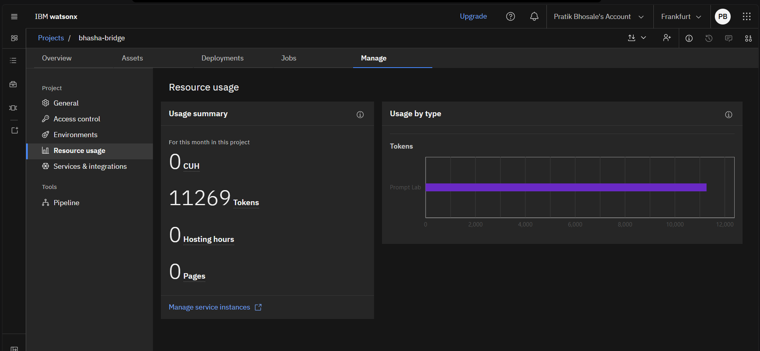
Token Usage
11,269 token are used
Before Prompt
After the Prompt
·
·
·

Slide 11
Novelty and Uniqueness
Bhasha Bridge stands out by combining AI-powered academic translation, content simplification and technical glossary generation into one educational application.
1. Academic Document Support – Supports multiple educational document formats, including PDF, DOCX, PPTX and TXT.
2. Structure Preservation – Protects formulas, code snippets, URLs, headings and numerical values during translation.
3. Student-Friendly Simplification – Provides a separate AI simplification feature to make complex academic topics easier to understand.
4. AI-Powered Glossary – Automatically identifies technical terms and provides their translations and definitions.
5. Side-by-Side Comparison – Allows students to compare original and translated content conveniently.
This makes Bhasha Bridge more than a basic translation tool by combining academic document processing, AI simplification and glossary generation in a single platform.

Slide 12
Git Hub Link
GitHub Repository: https://github.com/pratikbhosale1534-arch/Bhasha-Bridge
Project Name: Bhasha Bridge – Multilingual Course Content Translator Agent
Deployment: https://bhasha-bridge-ten.vercel.app/
·
·
·

Slide 13
Future Scope
1. OCR Integration – Adding Optical Character Recognition (OCR) will allow students to upload scanned PDFs and image-based educational documents for translation.
2. Improved Indian Language Support – Enhancing translation quality for Hindi, Marathi and other regional languages through better language models and human-reviewed terminology.
3. Voice-Based Translation – Introducing speech input and audio output to make educational content more accessible.
4. AI-Powered Learning Assistant – Extending the application with additional educational features such as quizzes, flashcards and interactive explanations.
5. User Authentication – Introducing secure student accounts and personalized document history.
6. Advanced Glossary Management – Allowing students to save, search and revise important academic terminology.
·
·
·

Slide 14
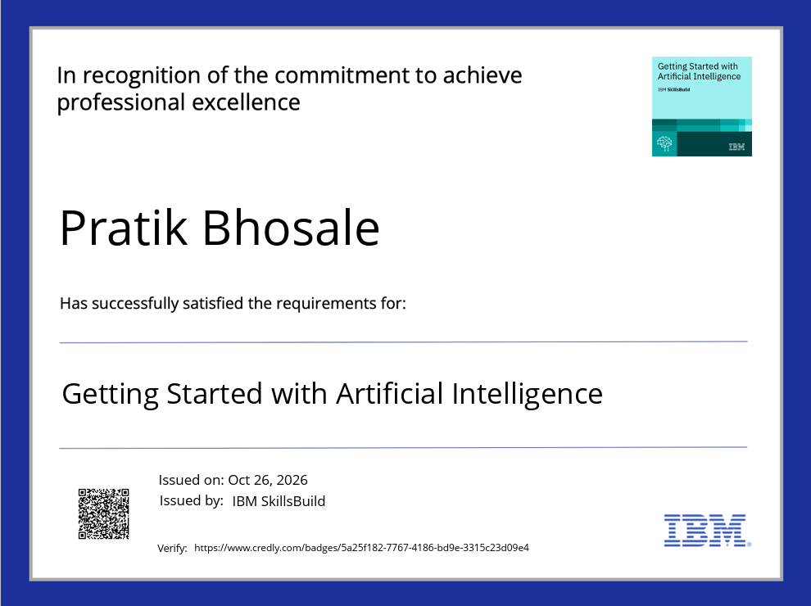
Certificates Earned:
IBM Credly Certificate

Slide 15
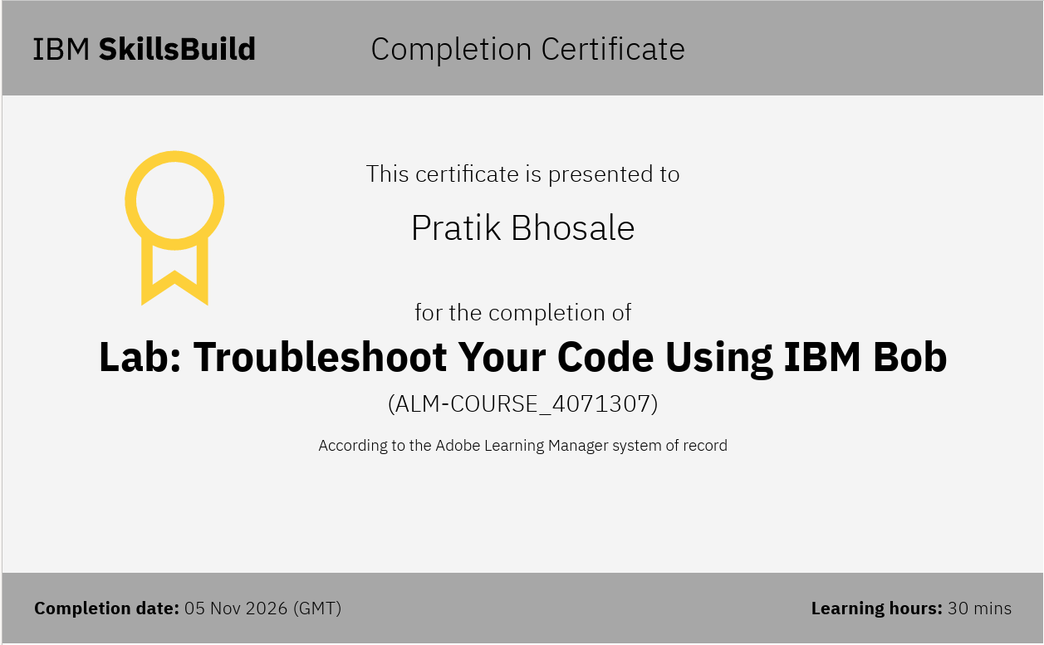
Certificates Earned:​
IBM BOB Certificate

Slide 16


